Slide 1
Android Prototype
By Desmond Wallace

Slide 2
Prototype Description
This android prototype is base on a music player app that uses a REST API to stream the music to device

Slide 3
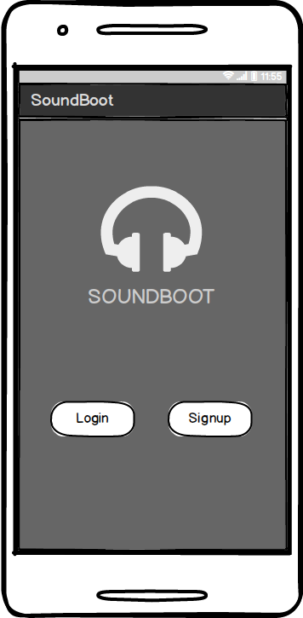
Start Page

Slide 4
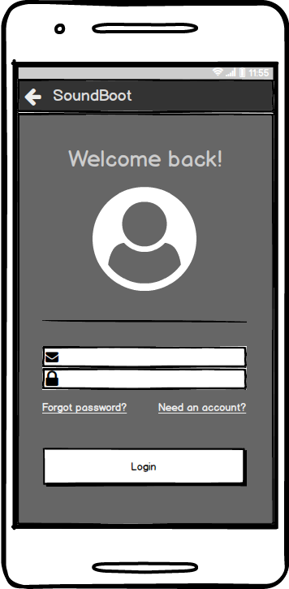
Login Page

Slide 5
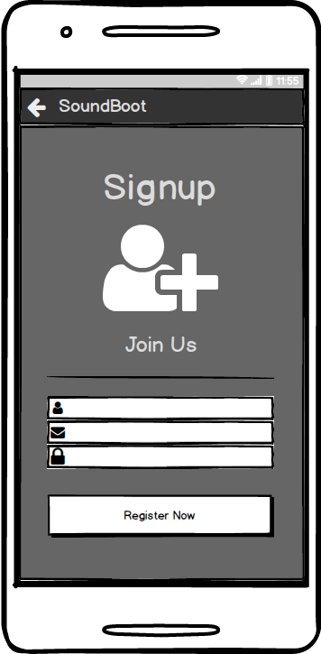
Signup Page

Slide 6
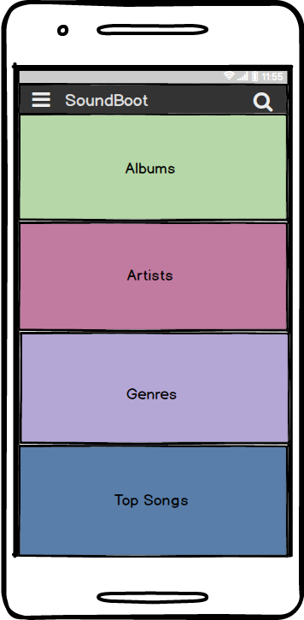
Home Page

Slide 7
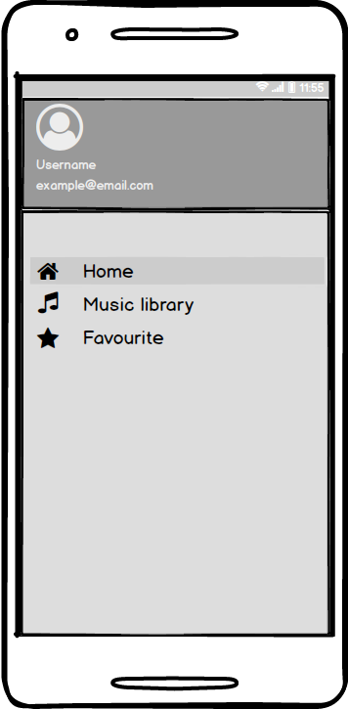
Menu

Slide 8
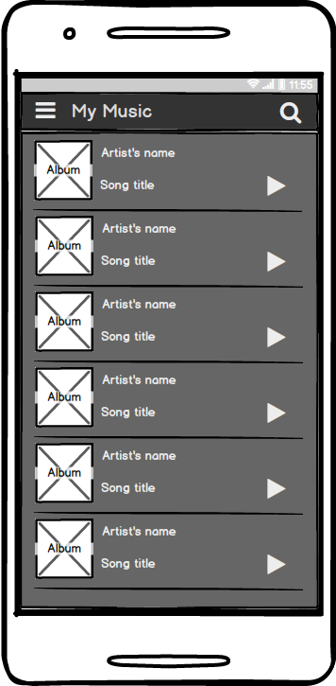
Music List

Slide 9
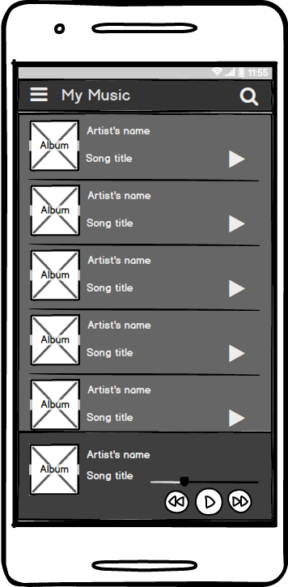
Music Play

